Slide 1
Staff Wellbeing

Slide 2
What is wellbeing?

Slide 3
What is Wellbeing?
…the state of being comfortable, healthy, happy or successful.
…having the psychological, social and physical resources needed to meet challenges.
…that part of an employee’s overall wellbeing that they perceive to be determined primarily by work and can be influenced by workplace interventions.

Slide 5

What has the biggest impact on wellbeing at work?

Slide 6
6 Causes – Management Standards
Demands (includes workload, working hours, deadlines, behaviour and anything that adds to the demands you face).
Control (the say staff have over what and how they work).
Support (from school and particularly from line managers, senior leaders and colleagues).
Relationships how well positive behaviours are encouraged and any inappropriate behaviours dealt with effectively and quickly).).
Role (staff know what is expected of them and how their work fits with that of their department and the aims of the school).
Change (and how it is managed).

Slide 7
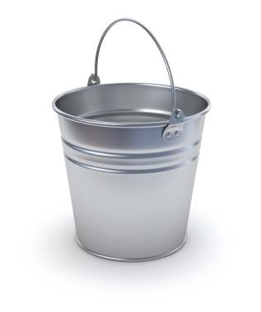

The Stress Bucket
Stress
Factors
Vulnerability
Factors
Things that cause the
stress level to rise
Not enough sleep
Workload
Finances
Bullying
Bereavement
Arguments
Lack of support
Change/uncertainty
Etc.
Size and strength of
your bucket
Coping
Strategies
Coping strategies
= holes to let out
the stress

Slide 8
The Stress Bucket
Bucket size varies!
Stress
Factors
Vulnerability
Factors
Things that cause the
stress level to rise
Not enough sleep
Workload
Finances
Bullying
Bereavement
Arguments
Lack of support
Change/uncertainty
Etc.
Size and strength of
your bucket
Coping
Strategies
Coping strategies
= holes to let out
the stress

Slide 9
What actions can you take?

Slide 10
Your stressors

Slide 11
Managing stress
Four options*
Avoid the stressor
Change the stressor
Adapt to the stressor
Accept the stressor
*This model was created by the Mayo clinic.

Slide 12
Avoid the stressor
Learn how to say ‘no’
Control your environment
Avoid hot-topic buttons
Prioritise
Avoid distractions and interruptions

Slide 13
Change the stressor
Express feelings rather than bottling them up
Be willing to compromise
Be more assertive
Plan ahead

Slide 14
Adapt to the stressor
Reframe problems
Look at the big picture
Adjust your standards – perfectionism is over-rated
Focus on the positive

Slide 15
Accept the stressor
Focus on the things you can control
Focus on the upside
Share your feelings
Learn to forgive

Slide 16
Managing stress – what else
Take a break and / or switch tasks
Do more of what you enjoy
Try and keep your sense of humour!

Slide 17
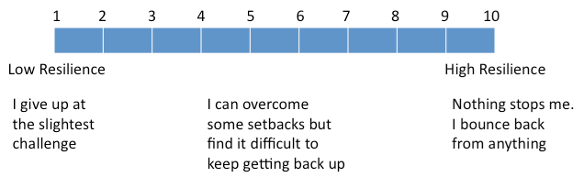
Your resilience

Slide 18
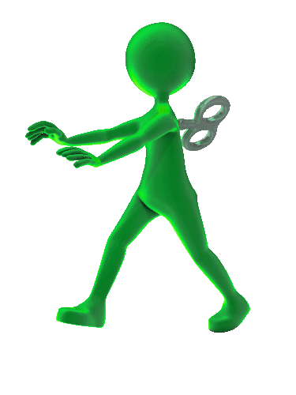
Self-Awareness
RESULTS

Slide 19
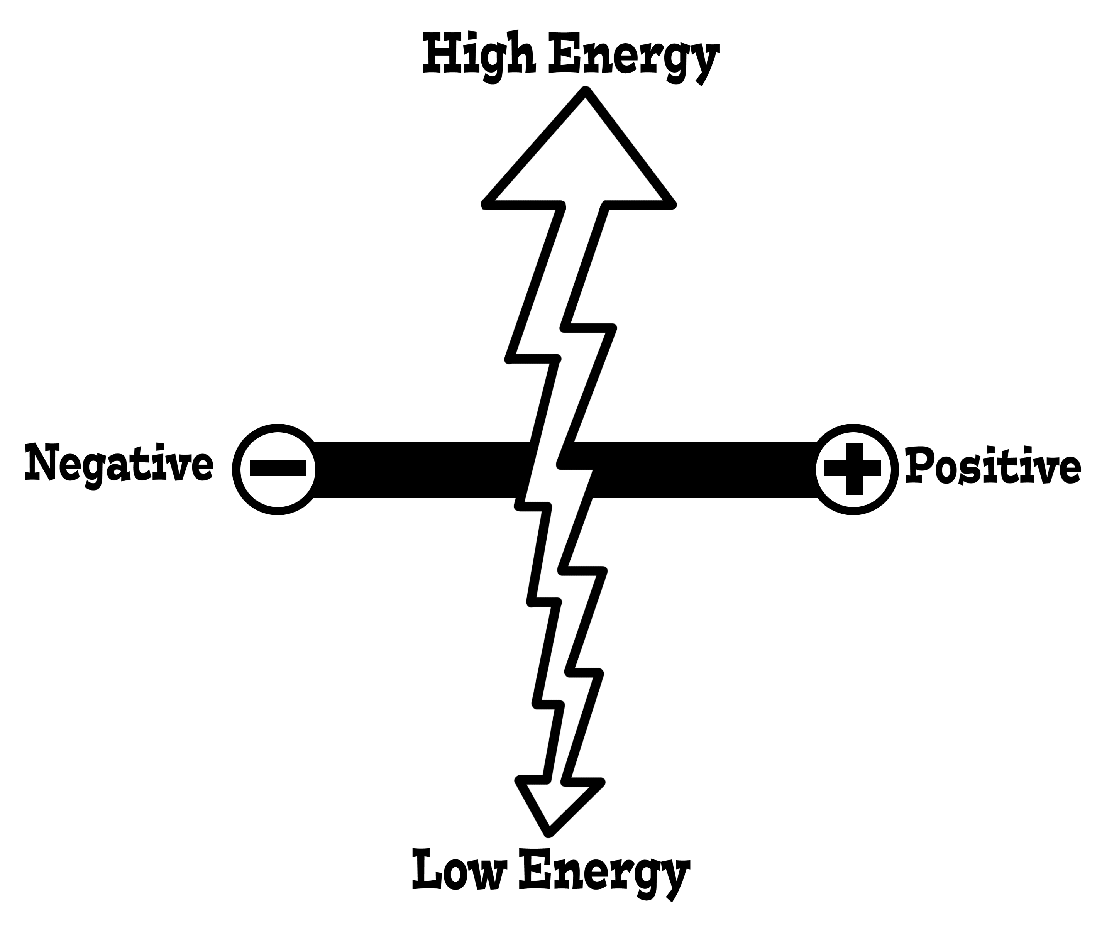
Your emotions

Slide 20
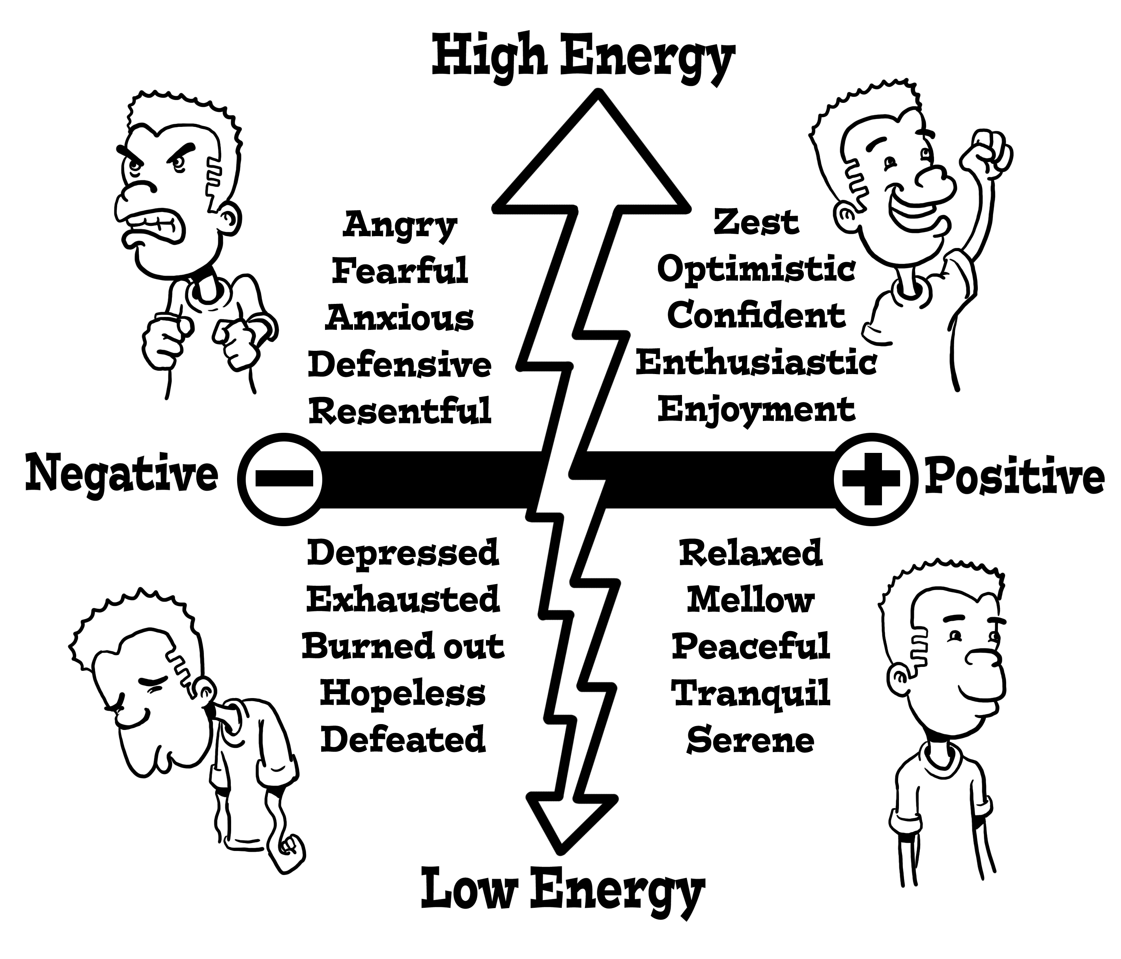
Your emotions

Slide 21




What is mindset?
Your Beliefs
How you see yourself?
How you see others?
How you see the world?

Slide 22
Your beliefs are important

Slide 23
What is mindset?
Your Beliefs
How you see yourself?
How you see others?
How you see the world?
Life isn’t fair!
The goal posts always move!
There are no guarantees in life!

Slide 24
Mindset
How might you develop some of these beliefs if they are not yours already?
  Life isn’t fair!
  The goal posts always move!
  There are no guarantees in life!

Slide 25
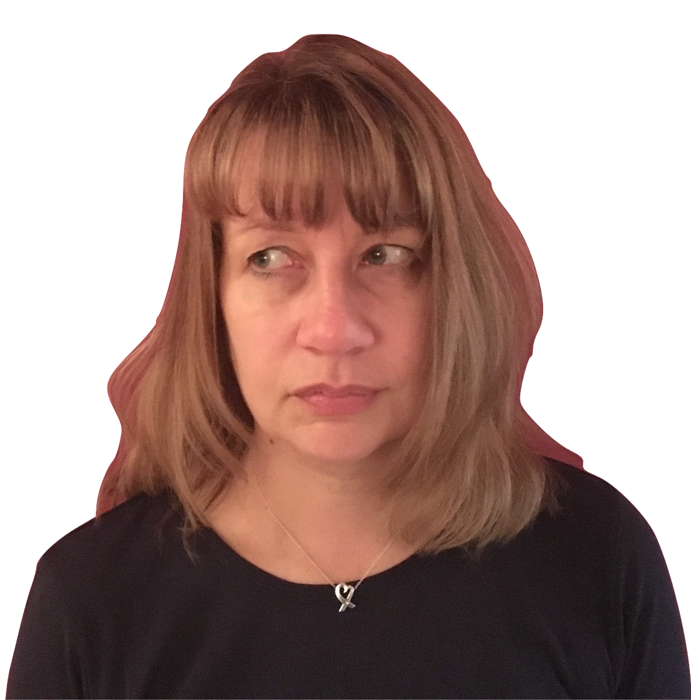
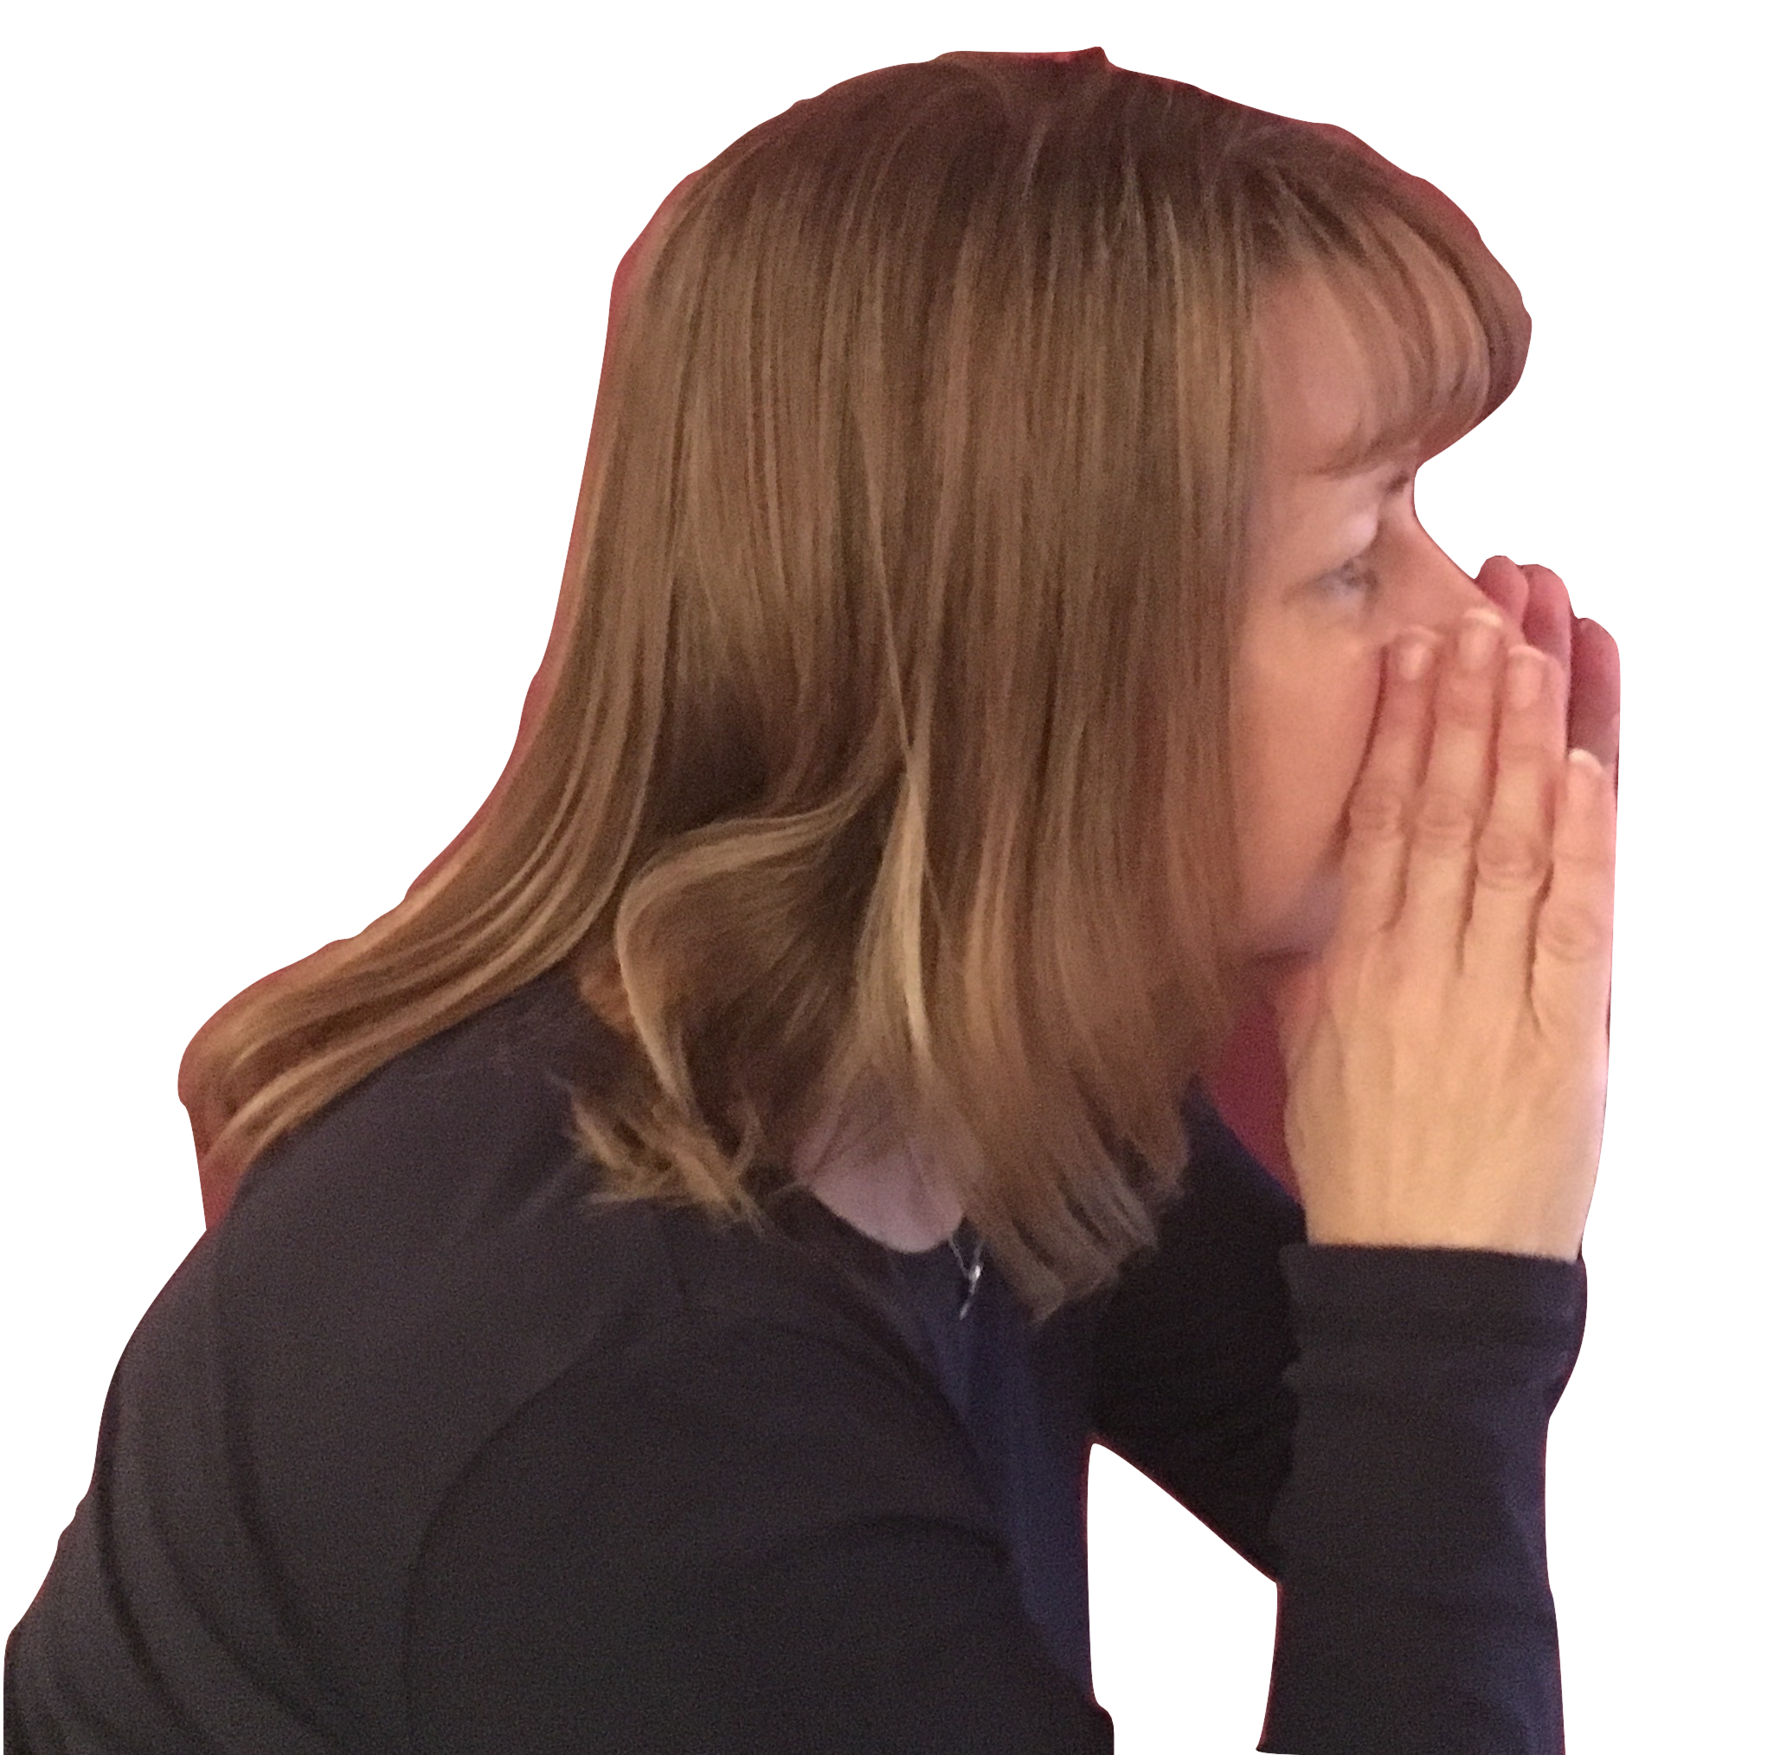
Your inner voice
What are some of the things you
say to yourself?

Slide 26
Positivity – Managing your inner voice
Dr. Barbara Fredrickson suggests that to be emotionally healthy we need a positive SELF TALK ratio of …

Slide 27
Positivity – Managing your inner voice
Dr. Barbara Fredrickson suggests that to be emotionally healthy we need a positive SELF TALK ratio of …
3:1

Slide 28

Choose your attitude
It really is your choice!

Slide 29
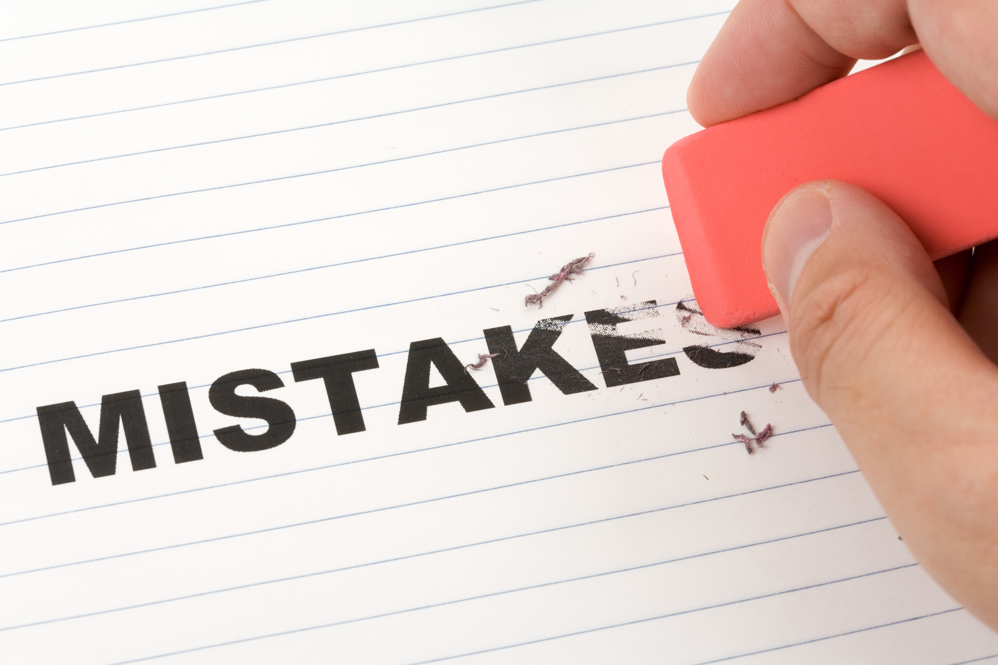
What’s the worst that could happen?

Slide 30

Win / lose or win / learn?
Think of a win / lose situation you are or have faced. What would have or will make it win / learn?

Slide 31
You will never get everything done
So Quit Trying!

Slide 32
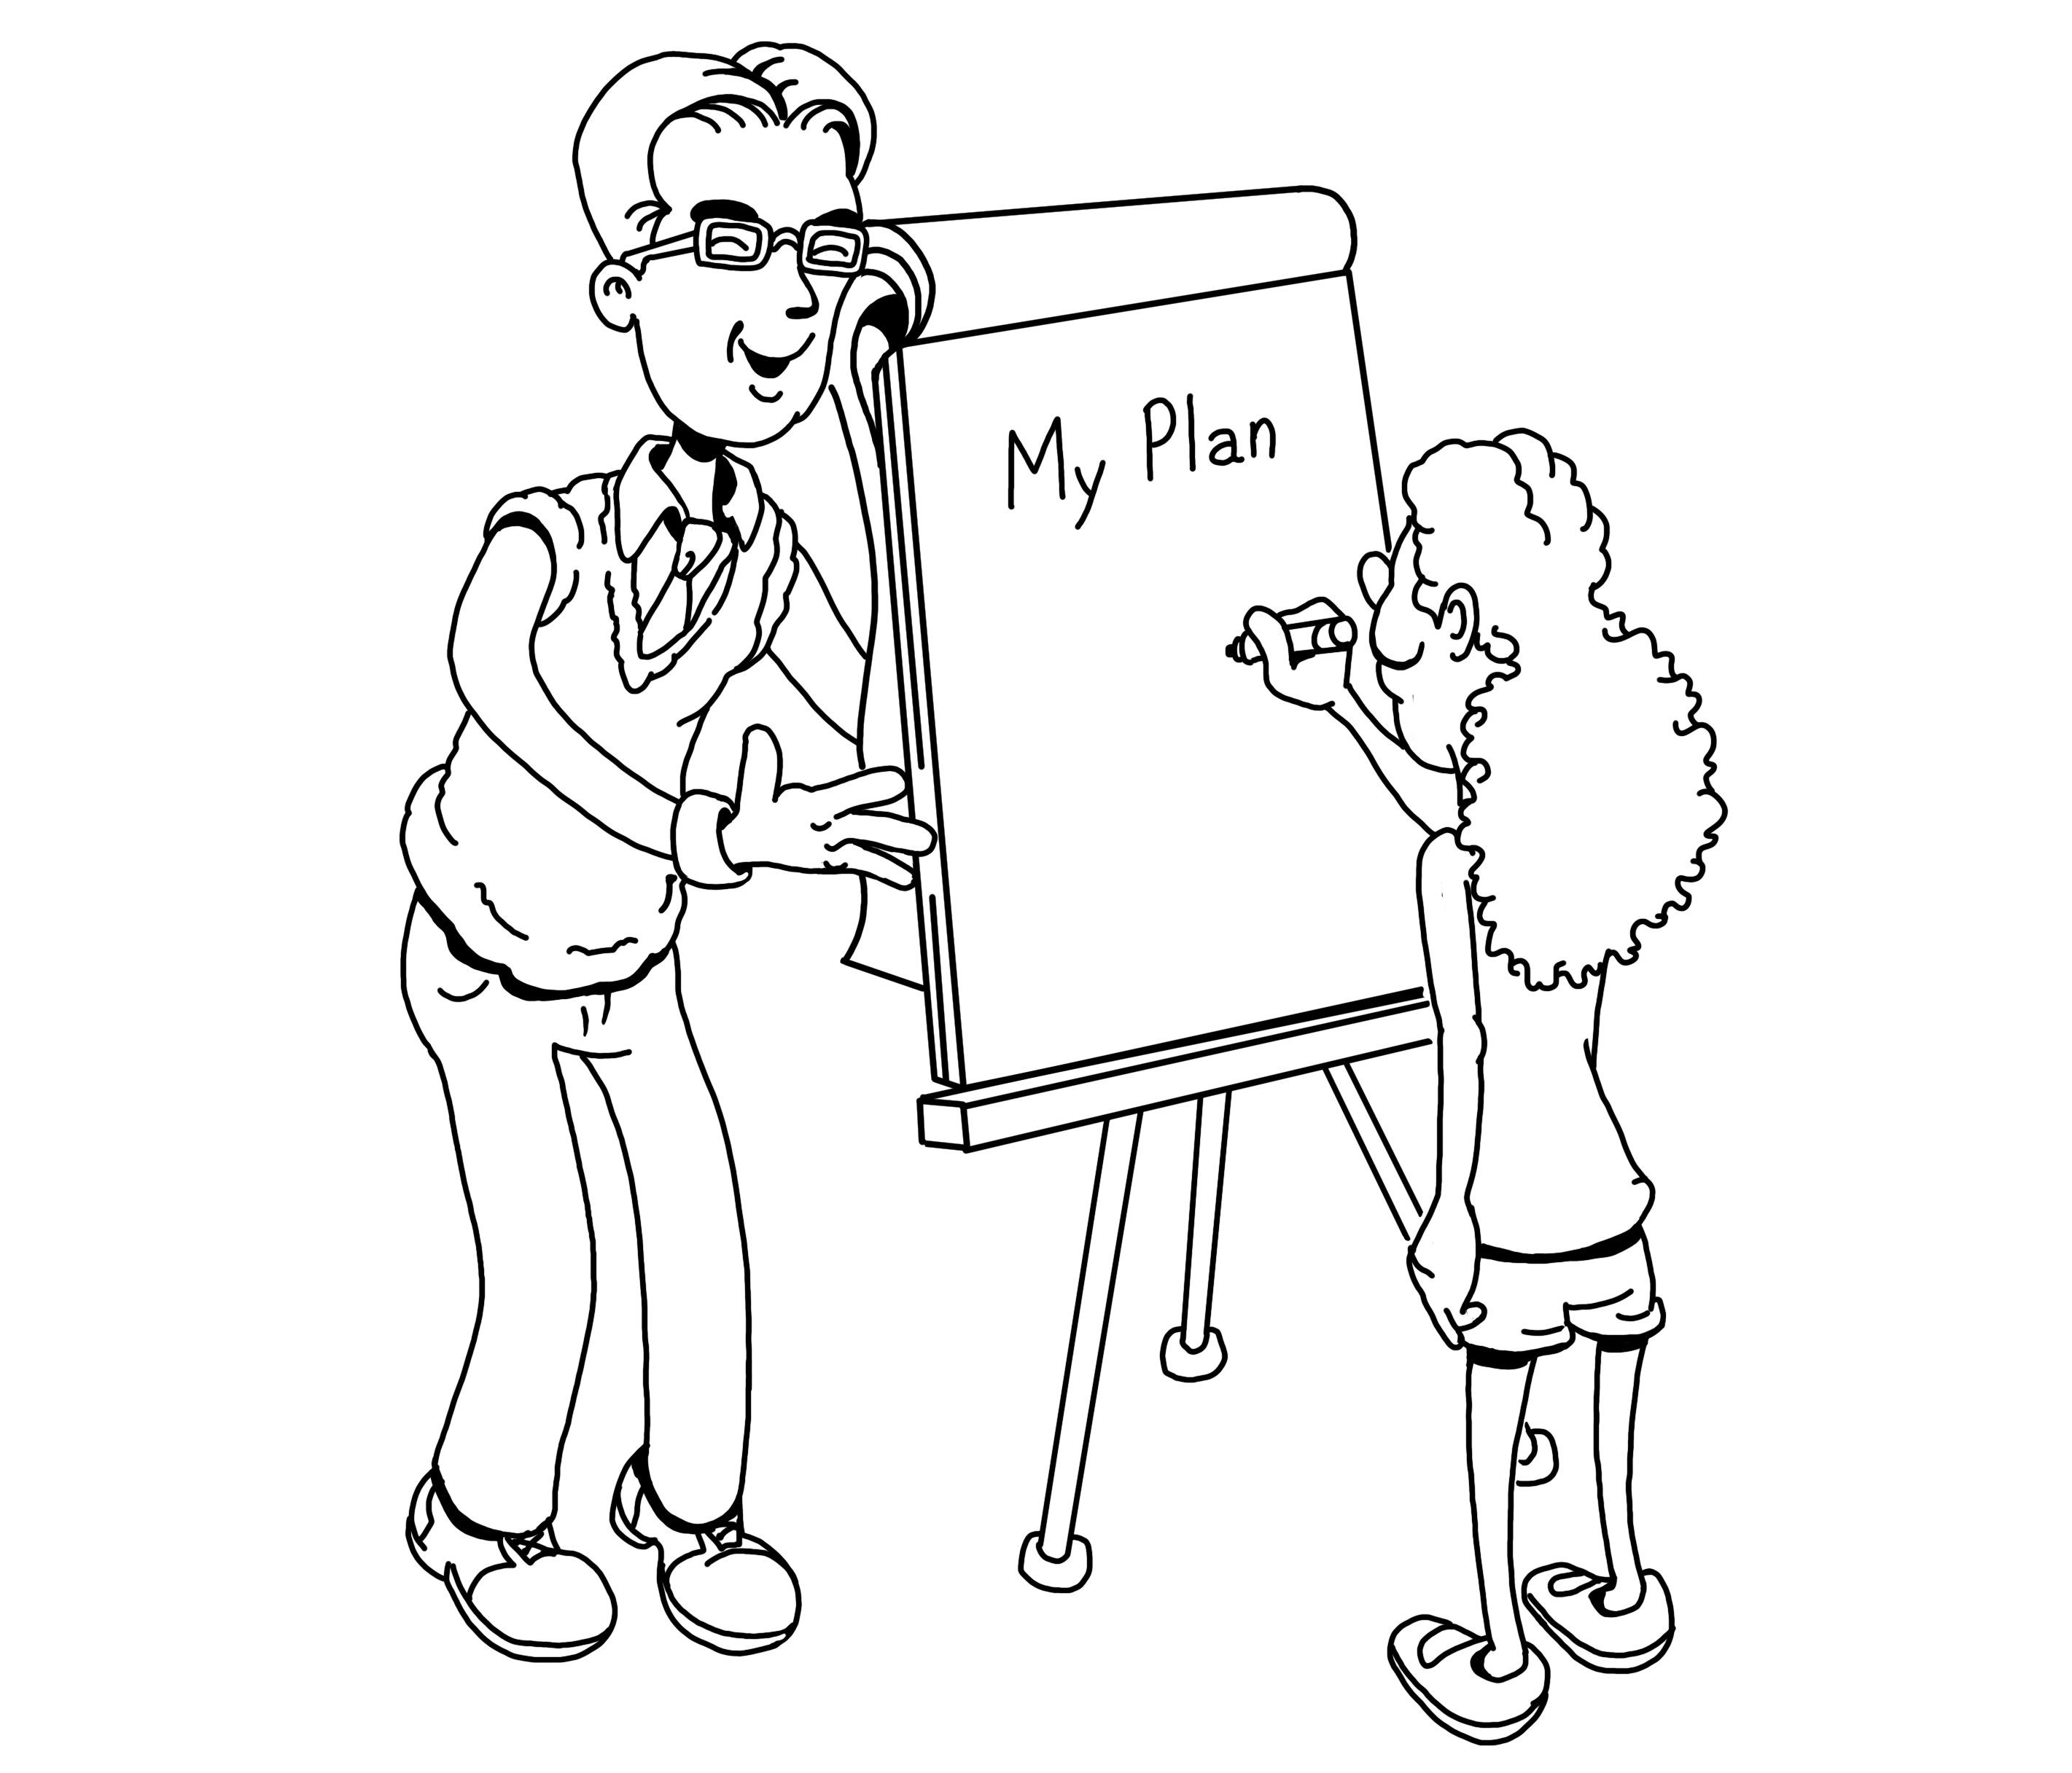
Personal Effectiveness
“Productivity is never an accident. It is always the result of a
commitment to excellence, intelligent planning, and focused effort.”
~ Paul J. Meyer ~

Slide 33
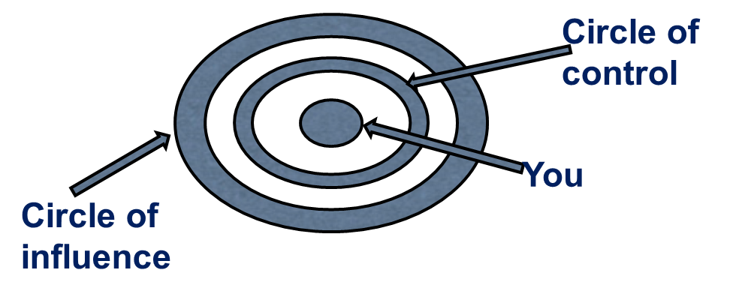
Control the Controllables!
What is within your control and what is not?
What can you do to focus on those things you can control?

Slide 34

Pareto Principle – 80 / 20 rule
How can you apply this to better manage your own workload?

Slide 35

Managing interruptions
Or multi-tasking?
What interruptions are you regularly faced with?
What are some steps you might take to better manage this?

Slide 36


Slide 37

How do I find the time for this?
What one thing can I do?
You have to start somewhere?

Slide 38
GET IN TOUCH
marksolomons@welbee.co.uk
01277 554001
https://welbee.co.uk

